Slide 1
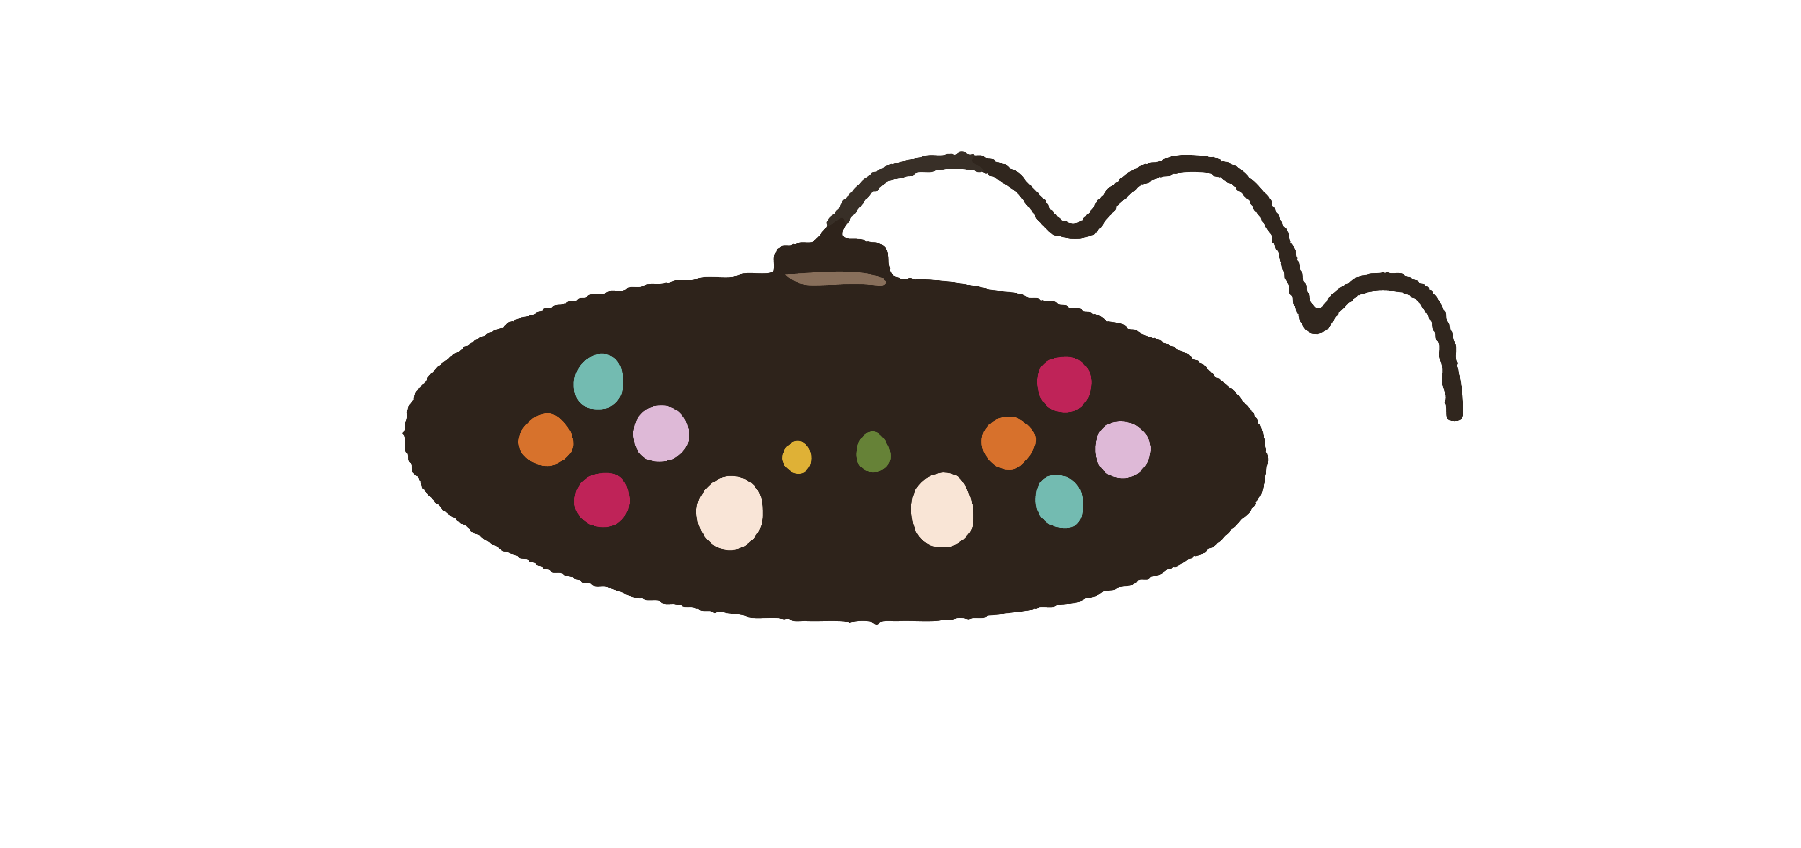

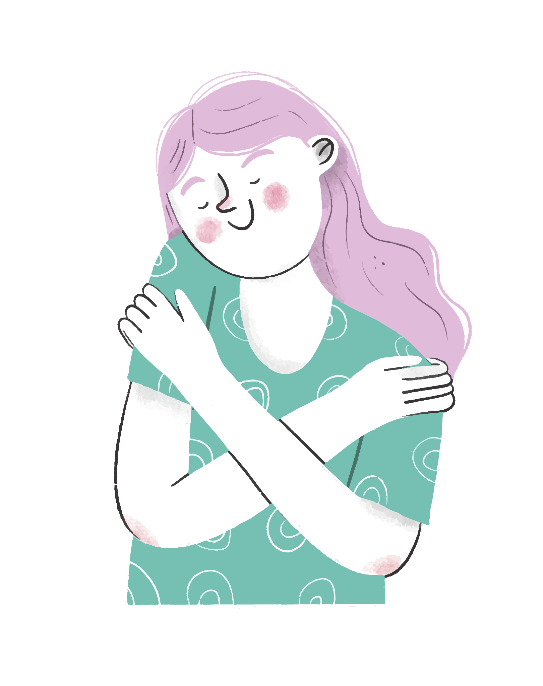




Review 5
Lesson 9: Personal care products and services
Lesson 10: Discuss ways to improve appearance

Slide 2
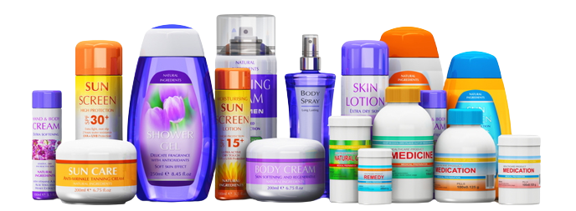
What did you learn last week? What are you going to learn today?

Slide 3
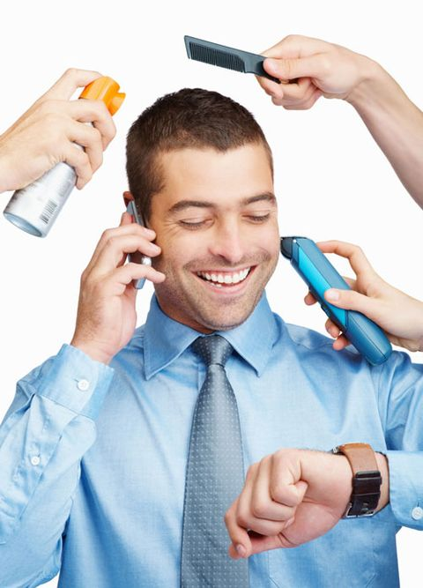
Objectives
Vocabulary
Personal care products and services
Discuss ways to improve appearance
Grammar
Quantifiers for indefinite quantities and amounts
Indefinite pronouns
Speaking topic
Talk about how you take care of your appearance

Slide 4



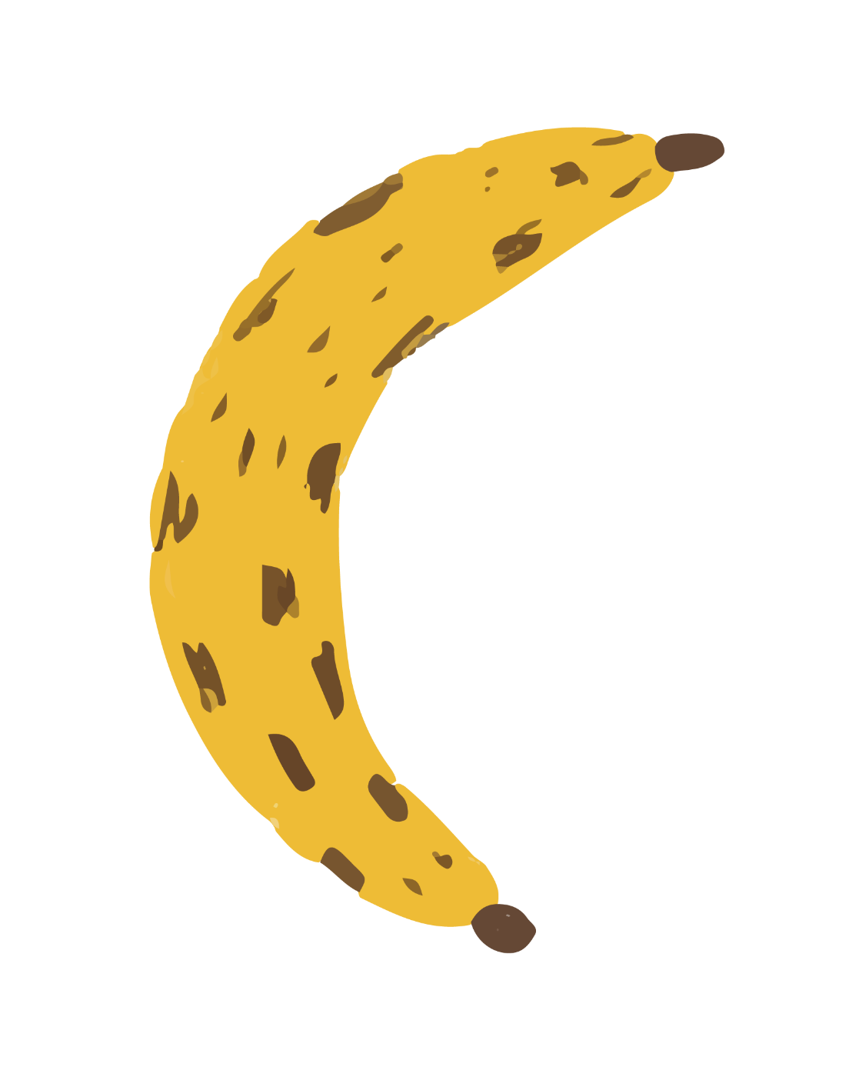
Vocabulary
Lesson 9: Personal care products and Services

Slide 5
Name some popular brands you use to take care of your appearance?
01:00

Slide 6

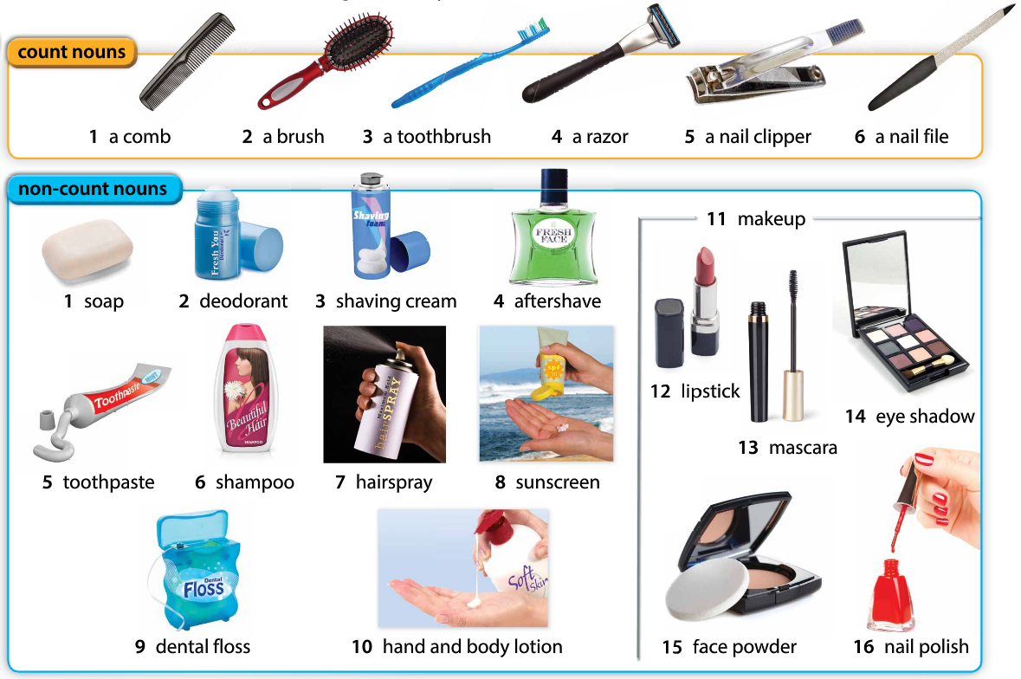
Personal care products
Notes:
Teacher asks student for the vocabulary hidden
Listen and repeat
Time limit: 5 minutes

Slide 7



Speaking
Are you happy with your appearance now?
Yes, I am. (I’m happy with my appearance now)
How often do you take care of your appearance?
I take care of my appearance every day before I go to sleep.
Do you spend a lot of money on cosmetic products?
Yes, I do. (I spend lots of money on cosmetic products because I care a lot about my appearance)
No, I don’t. (I don’t spend much money on cosmetic products because I’m confident in my appearance now)
Notes:
Pair work
Time limit: 5 minutes

Slide 8
Team work
In a team, answer these two questions: (5-7 minutes)
How do you take care of your skin/hair/teeth/nail?
Which personal care product(s) do you use for your skin/hair/teeth/nail?

Slide 9
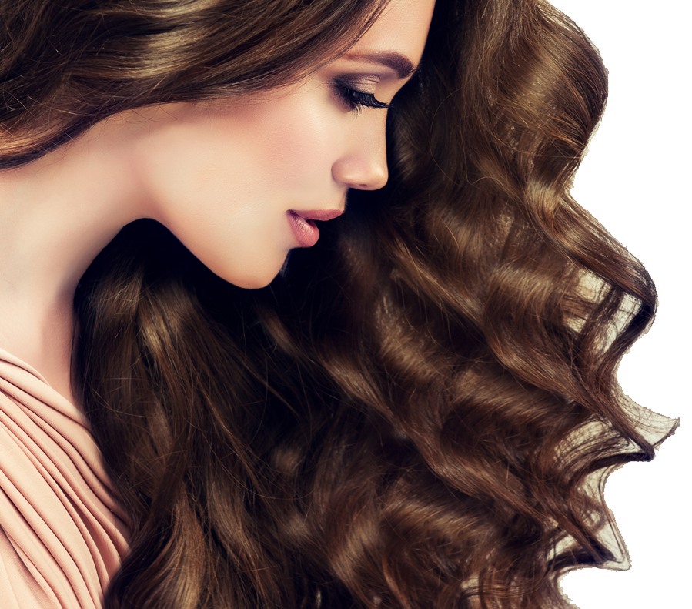
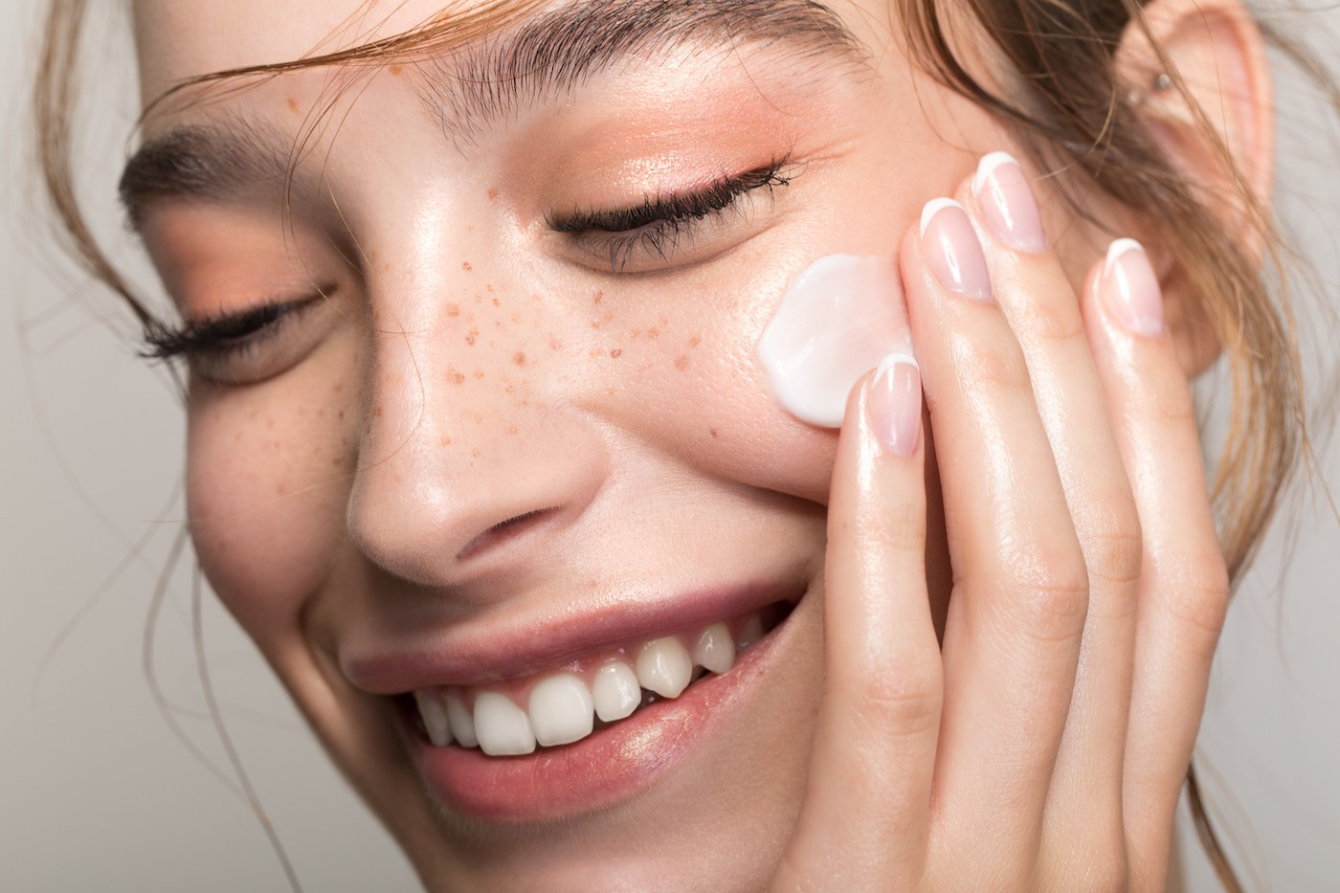
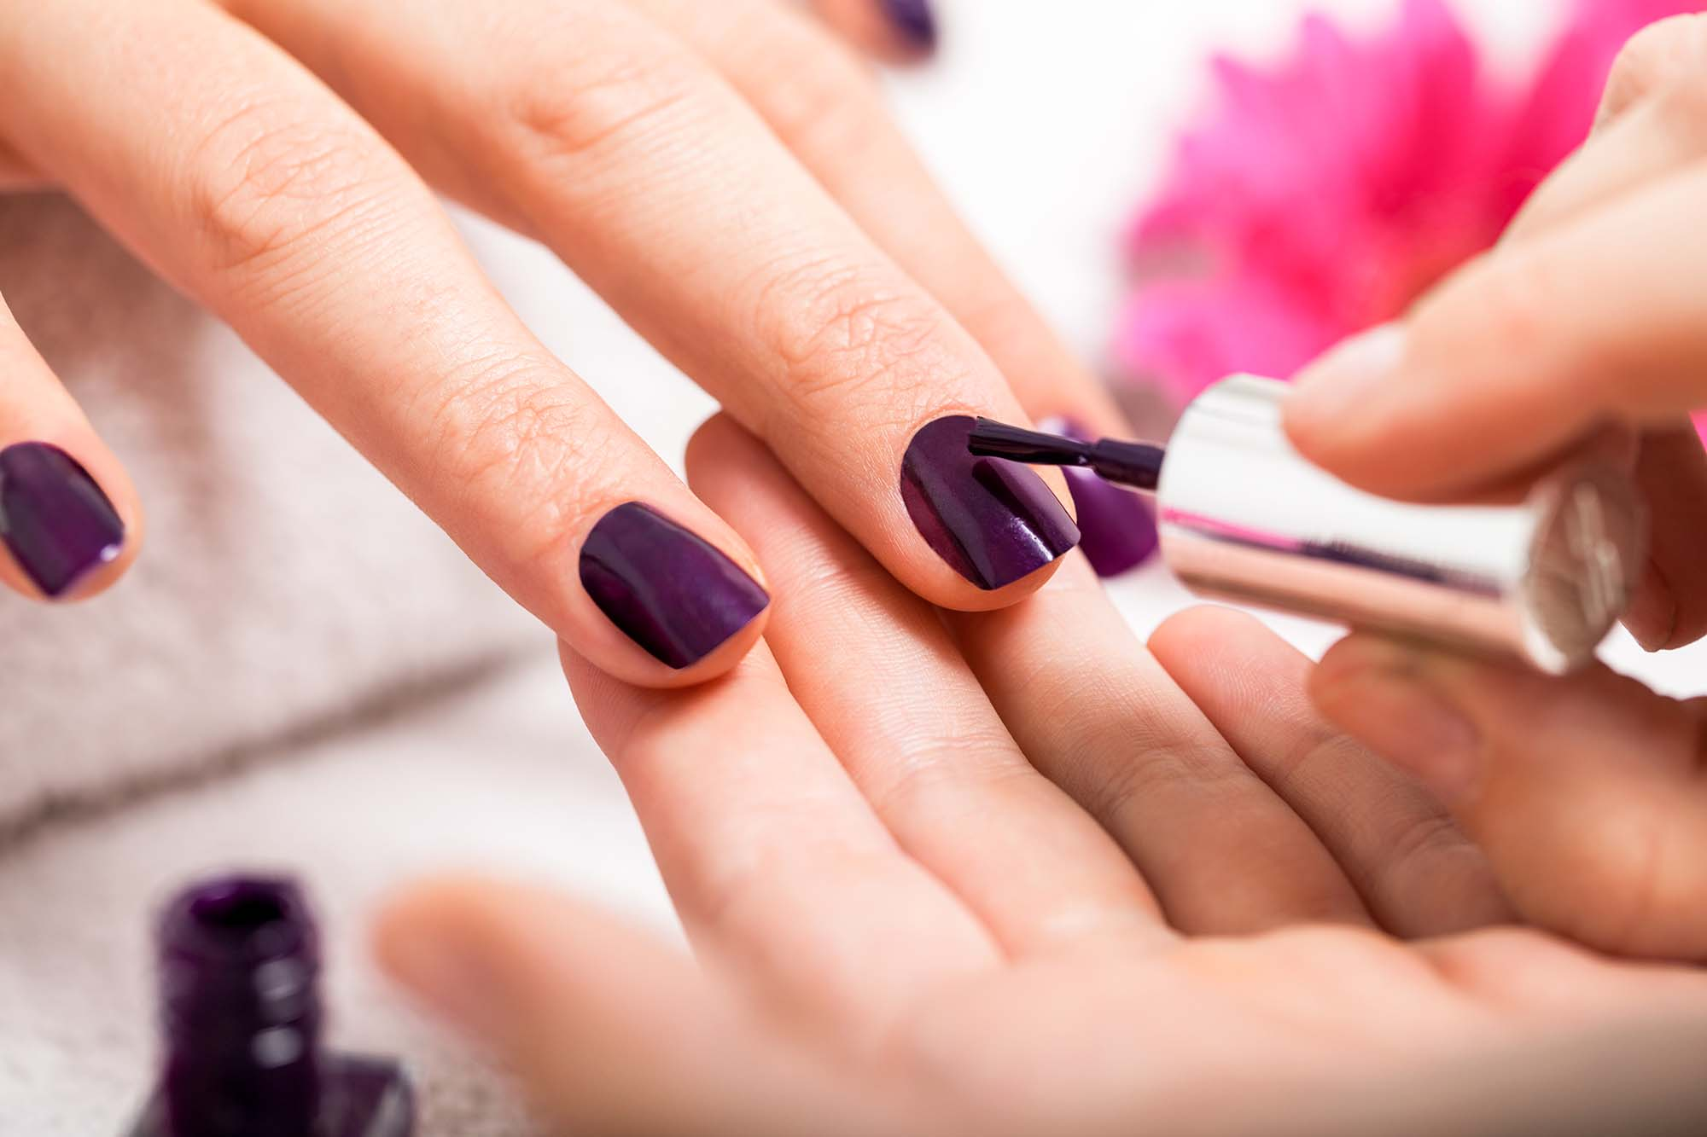
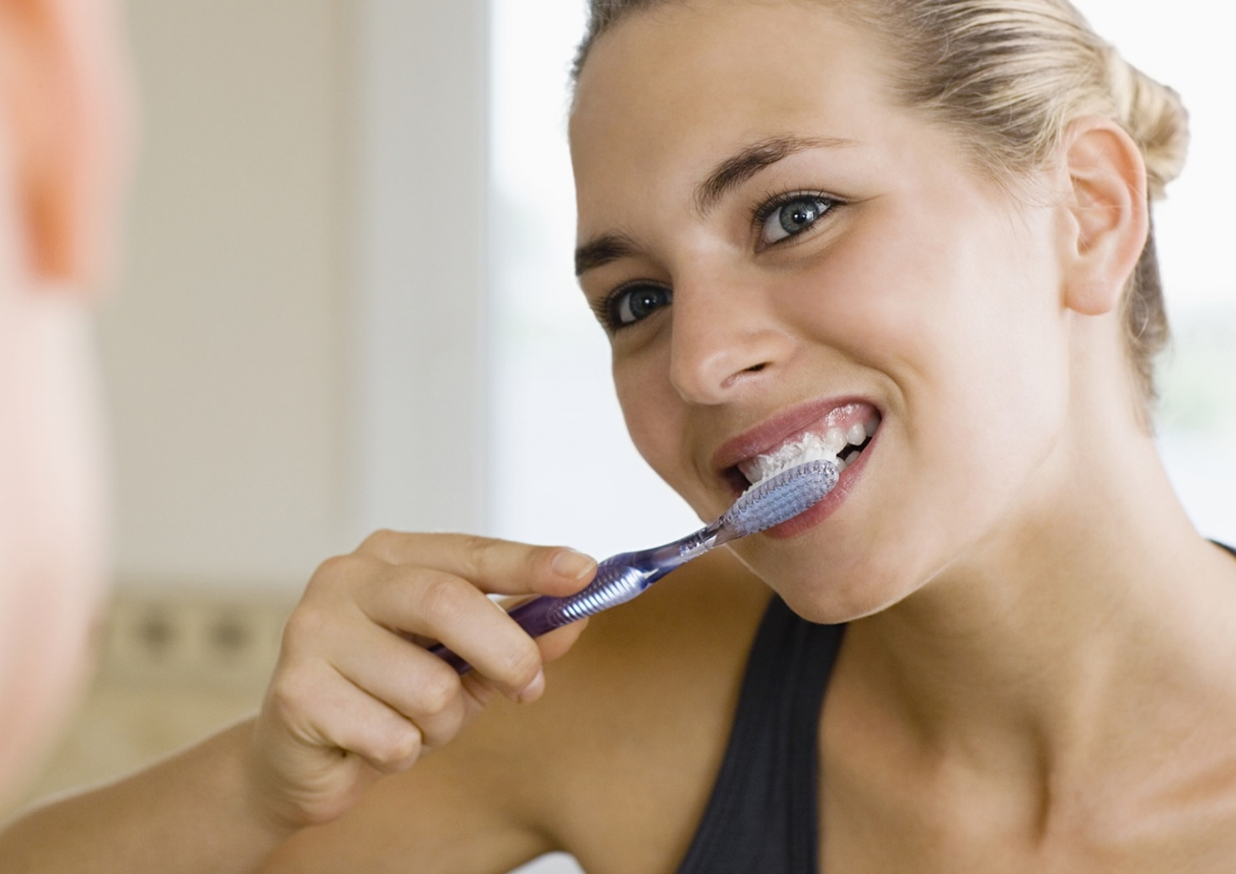
Useful language
Structures | Words (skin)
- To take care of my skin, I usually use ... - To care for my skin, I often use ... - The best choice for my skin is ... - For my skin, I always spend money on ... | - foaming face wash - moisturizer - cream - facial mask
Words (hair)
- shampoo - hair conditioner - hair serum - hair oil
Words (teeth)
- toothpaste - toothbrush - dental floss - mouth wash
Words (nail)
- nail clippers - nail polish - soap - nail cream
Notes:
Teacher shows students some useful language before their work, encourages them to share more words with other teams

Slide 10
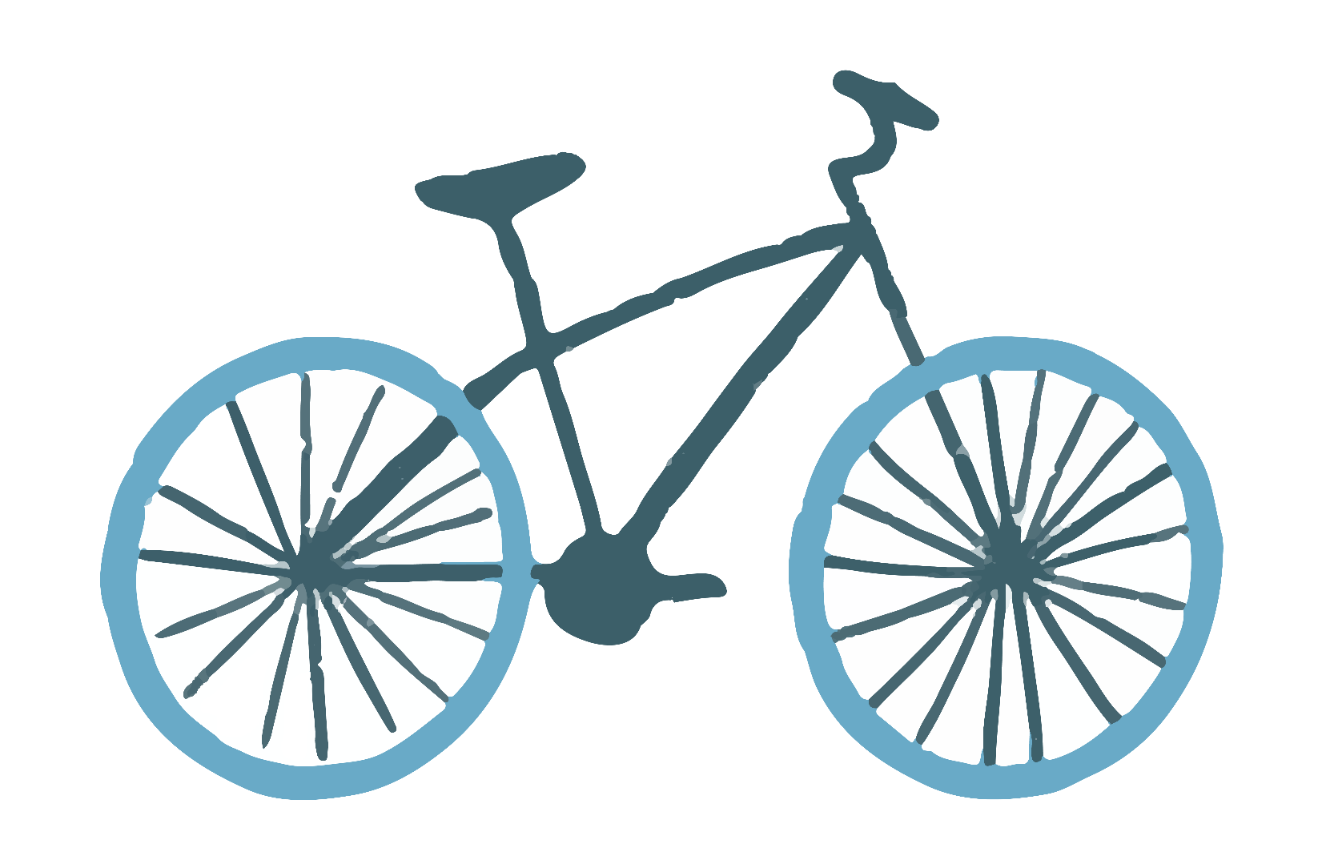
Grammar
Quantifiers for indefinite quantities and amounts

Slide 11
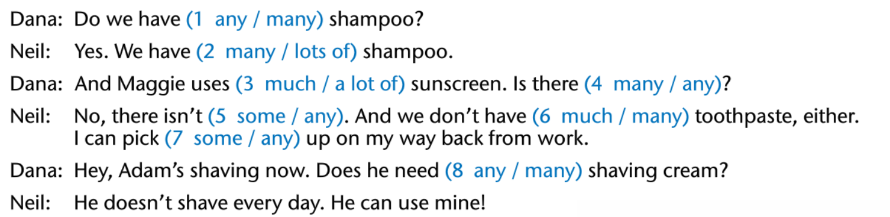
Practice
1. When do you use ‘any’?
We use ‘any’ in Questions, count and non-count nouns
2. When do you use ‘lots of’?
We use ‘lots of’ in Affirmative, count and non-count nouns
3. When do you use ‘a lot of’?
We use ‘a lot of’ in Affirmative, count and non-count nouns
4. When do you use ‘any’?
We use ‘any’ in Negative, count and non-count nouns
5. When do you use ‘much’?
We use ‘much’ in Negative, non-count nouns
6. When do you use ‘many’?
We use ‘many’ in Negative, count nouns
Notes:
Teacher also explains when to use ‘some’: in Affirmative, in Questions for invitation, asking for help,...

Slide 12
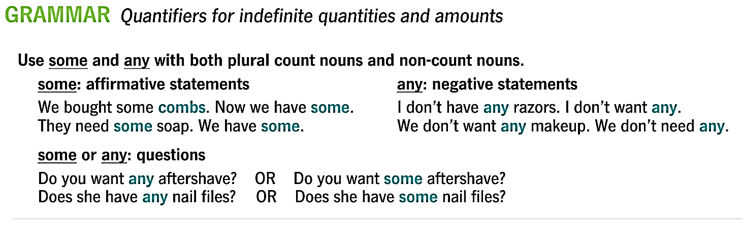
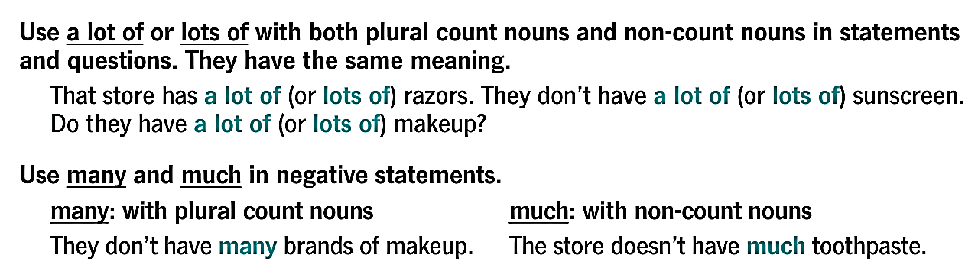
Notes:
Quick review

Slide 13
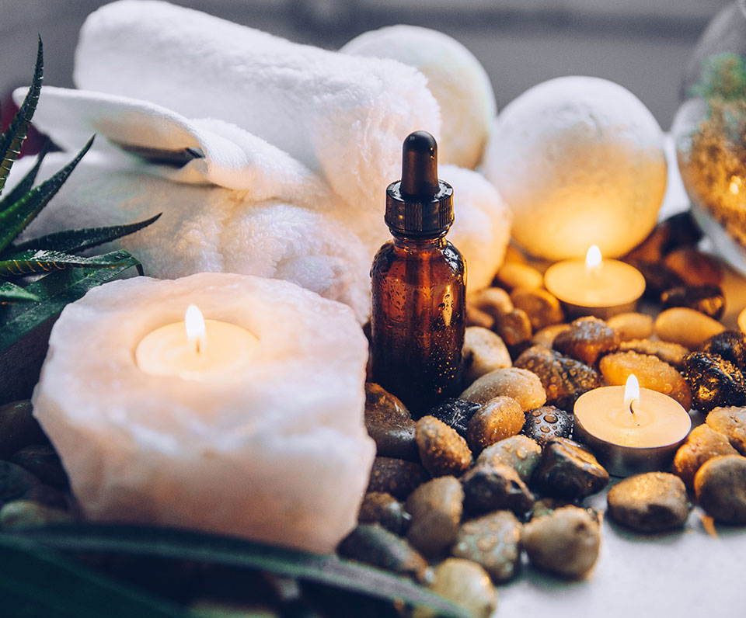
How often do you go to the hair salon / spa / barber shop?
Notes:
Teacher asks this question to elicit the next part of vocabulary (services)
Teacher can also ask a following question: What services do you usually use there?

Slide 14
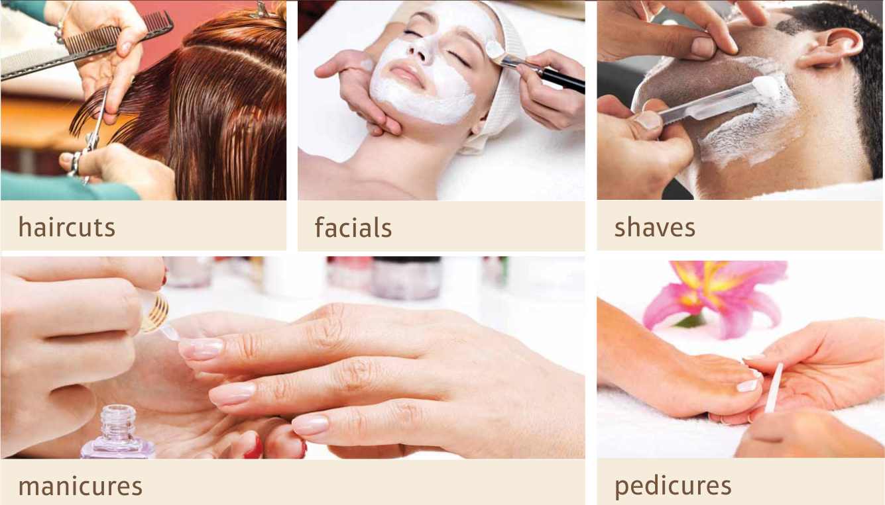
Salon services
?
?
?
?
?
A manicure
A pedicure
Notes:
teacher asks students what these services are and then uncovers the boxes
pronunciation check

Slide 15
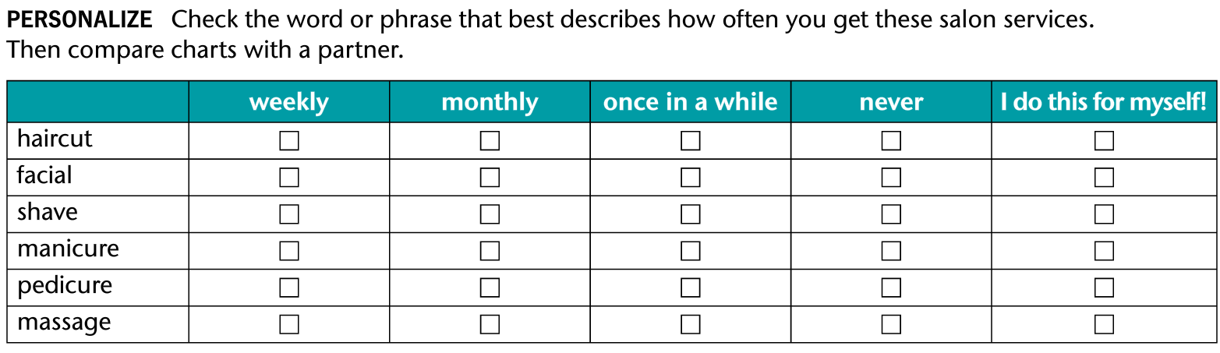
Pair work (5-6 minutes): How often do you have a haircut? Do you go to a hair salon?
Notes:
Teacher asks first: How often do you have a haircut? Do you have a haircut at a hair salon? Students ask each other the same questions about other services

Slide 16
Team work
In a team, answer these four questions: (10 minutes)
What is your favorite salon / spa or barber shop?
Where is the salon / spa / barber shop located?
Who do you go there with?
Which service(s) do you usually get when you go to that salon / spa?
How much do you have to pay for each time?

Slide 17
Useful language
- The spa is located on …. Nguyen Hue street.
- The salon is on … Quang Trung road.
- I go there with … my friend.
- I and my friend usually go to the spa (there)... together.
- I go to the spa (there) when I want to have ... a massage.
- I’d like to have … my hair cut at the salon (there).
- I usually pay … 500k for the service (a manicure) each time.
- The pedicure (It) usually costs me ... 500k each time.
Notes:
Teacher shouldn’t show suggestions to students when elitciting
Teacher may show suggestions if it’s a weak class

Slide 18
Grammar
Indefinite pronouns

Slide 19
Unscramble the sentences?
I / anyone / a / don’t see / haircut / having
I don’t see anyone having a haircut.
Negative
Notes:
teaccher asks students when to use ‘anyone’after showing 2 circles

Slide 20
Unscramble the sentences?
you / someone / a massage / can / give / today
Someone can give you a massage today.
Affirmative

Slide 21
Unscramble the sentences?
Sorry! / a manicure / no one / you / give / can / today
Sorry! No one can give you a manicure today.
Affirmative
Notes:
teacher explains that ‘no one’is used in Affirmative but it has a negative meaning

Slide 22
Unscramble the sentences?
to do / think / anyone / we don’t / there’s / you / available / today / your hair
We don’t think there’s anyone available to do your hair today.
Negative

Slide 23
Unscramble the sentences?
someone / shave / give / tomorrow / you / can / a
Someone can give you a shave tomorrow.
Affirmative

Slide 24
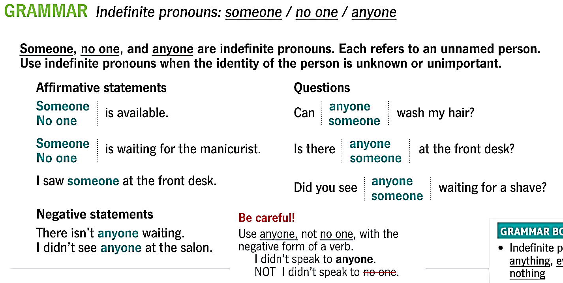
Notes:
Quick review

Slide 25
Vocabulary
Unit 10: Appearance

Slide 26
Name some ways you can do to improve your appearance?
01:00

Slide 27
Match the pictures to the vocabulary to review ways to improve the appearance
Notes:
time limit: <5 minutes

Slide 28
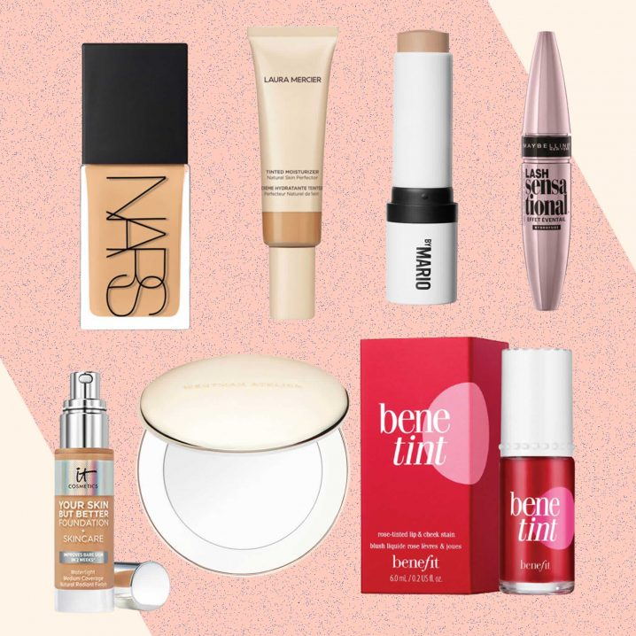
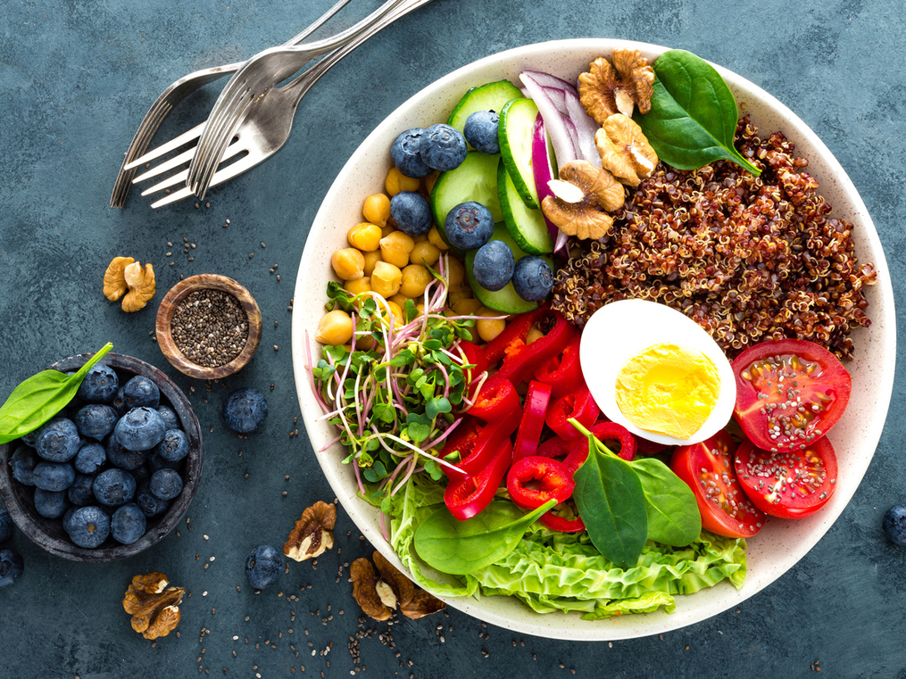
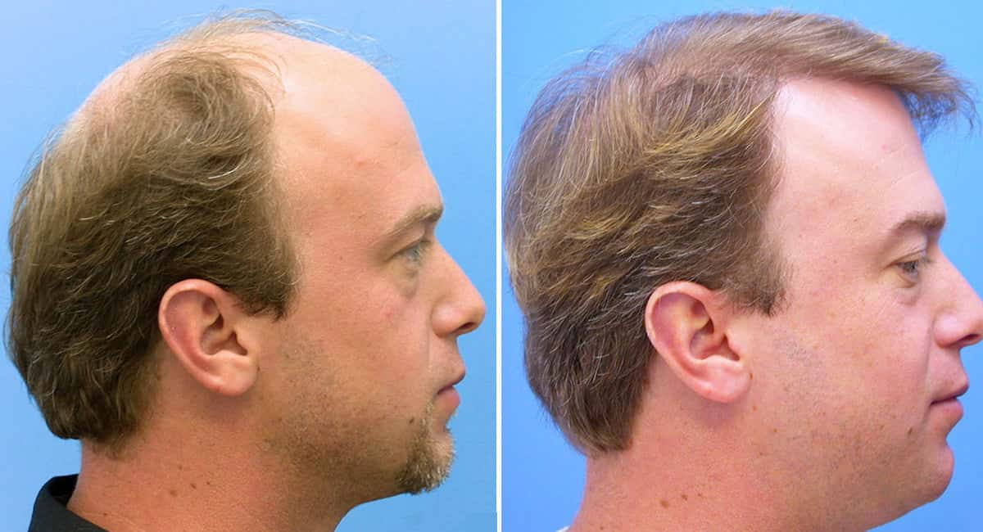
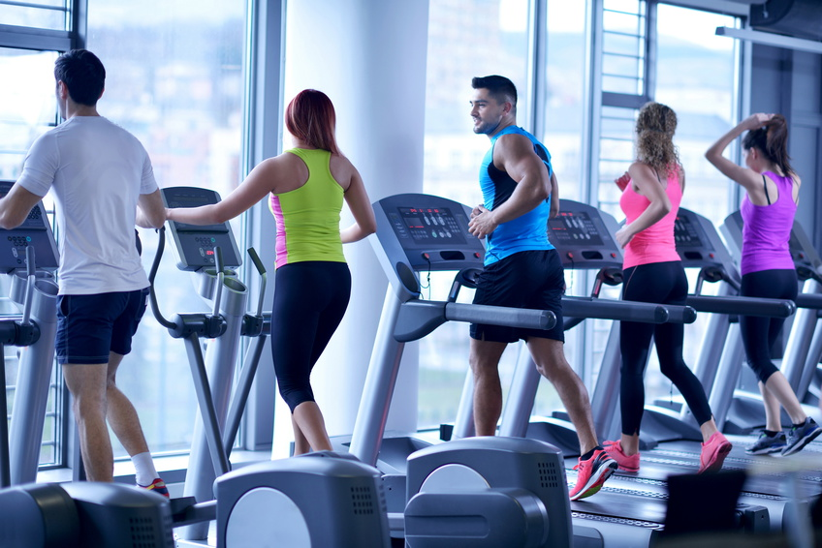
Diet
(Do) exercise
Hair restoration
Cosmetics and makeups

Slide 29
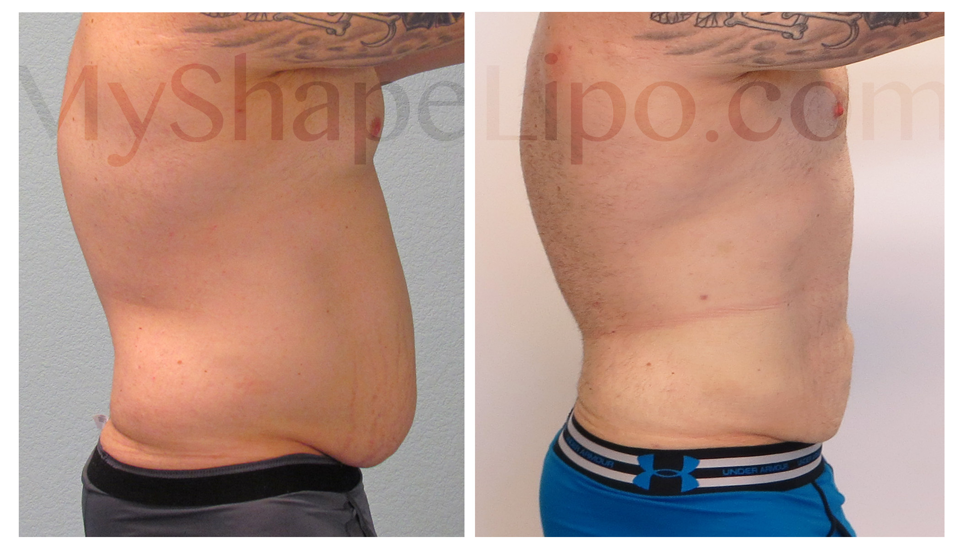
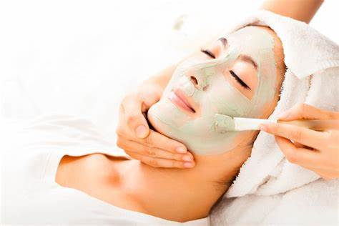
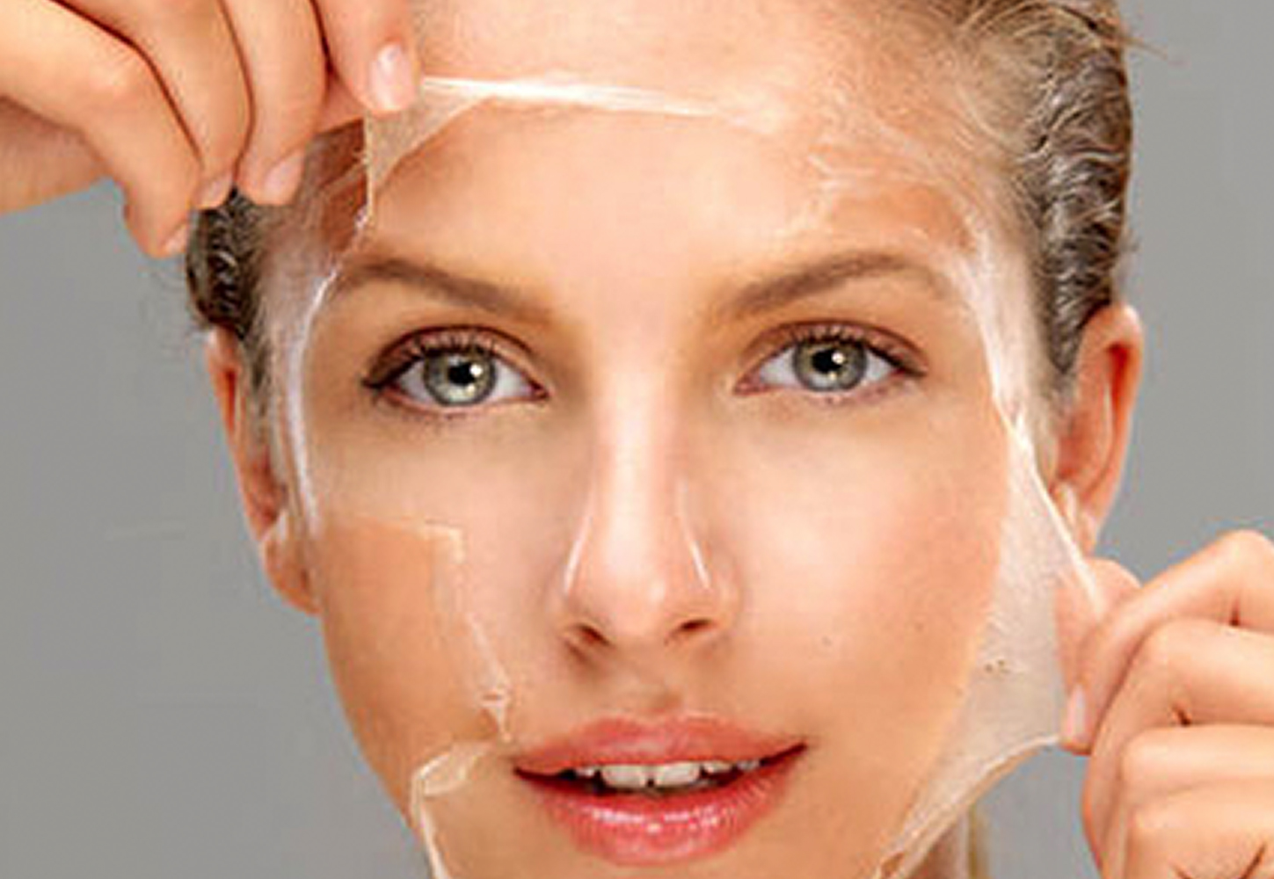
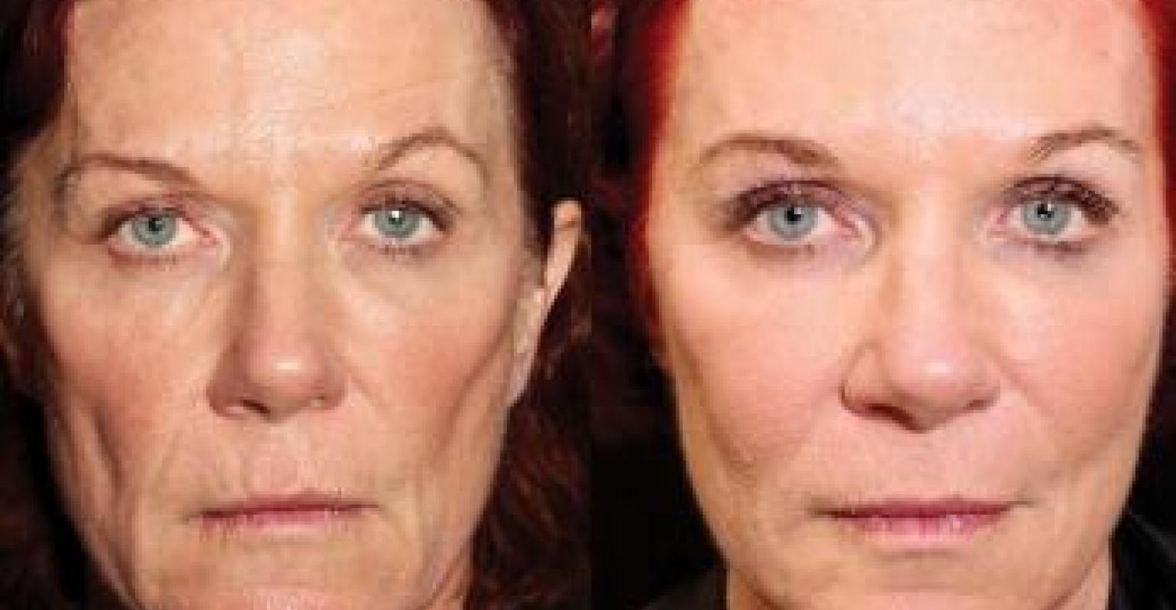
Facials
Face-lifts
Liposuction
Chemical peels

Slide 30
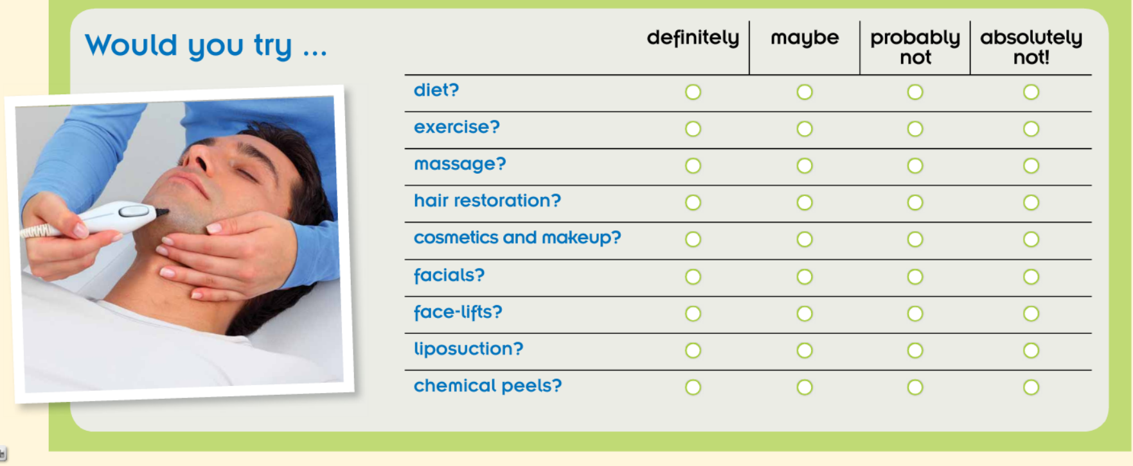
Pair work: Would you try ...?
Notes:
Time limit: 5 minutes

Slide 31
Team work
In a team, discuss the advantages and disadvantages of cosmetic surgery: (10-12 minutes)
Good (advantages): It’s good because ... / The advantages are ... | Bad (disadvantages): It’s bad because ... / The disadvantages are ...
- It makes me feel more confident and confidence makes me successful. - I would look more desirable. - One good point is it would make me younger when I get old. - If I had enough money, I would have cosmetic surgery because (an advantage above) | - It risks my life / money / ... because there may be something wrong in the operation. - There are side effects (marks, scars,...). - It costs a lot of money / time ... - If I had enough money, I would spend on other things (...) but not cosmetic surgery because (a disadvantage above)

Slide 32
What have we learned today?
Vocabulary
Personal care products and Services
Ways to improve appearance
Grammar
Quantifiers for indefinite quantities and amounts
Indefinite pronouns

Slide 33
Speaking topic
Talk about how you take care of your appearance

Slide 34
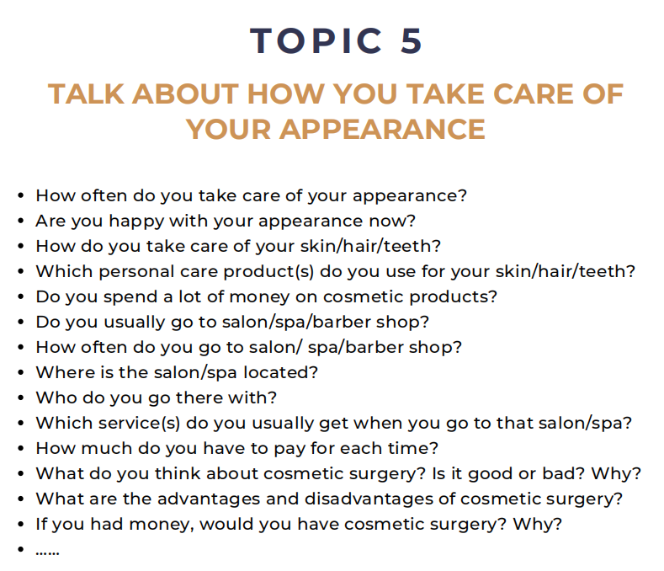

Slide 35
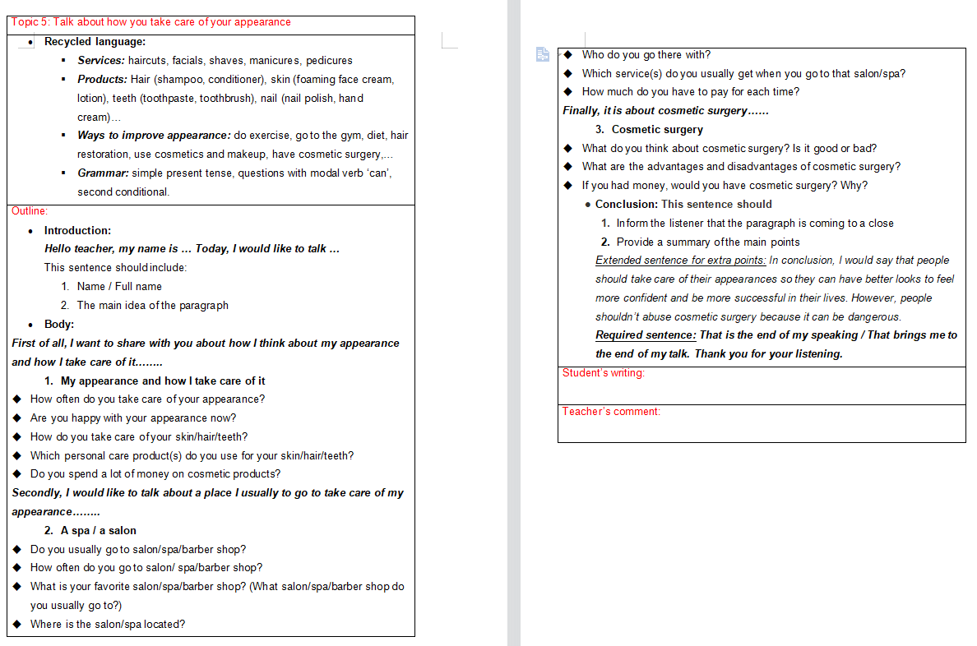

Slide 36
Thank you

